Slide 1

The future of research: Accessibility in Data Work
Invited Talk, UC, Fall 2022
axle-lab.com
Thinking about data work and people with disabilities.
Frank Elavsky, PhD student at Carnegie Mellon University

Slide 2
Who am I? A data visualization + accessibility researcher and engineer
Research: Carnegie Mellon and Apple.
Organize: DataVizA11y.
Contribute: W3C’s ARIA Working Group as an invited expert.
Create: Tools for designers and engineers who want to make accessible visualizations.

Slide 3
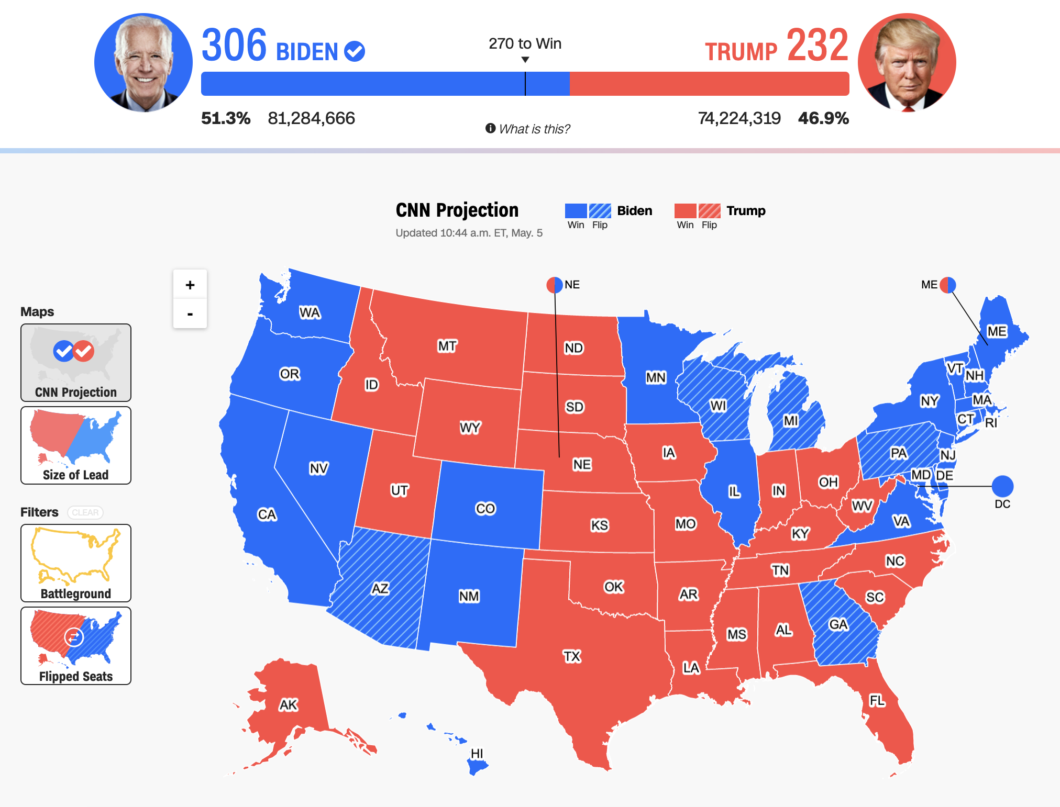
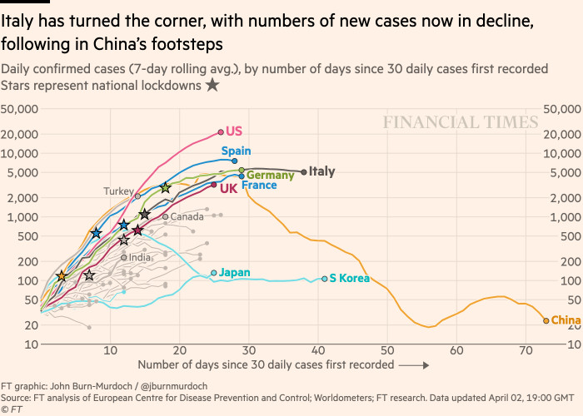
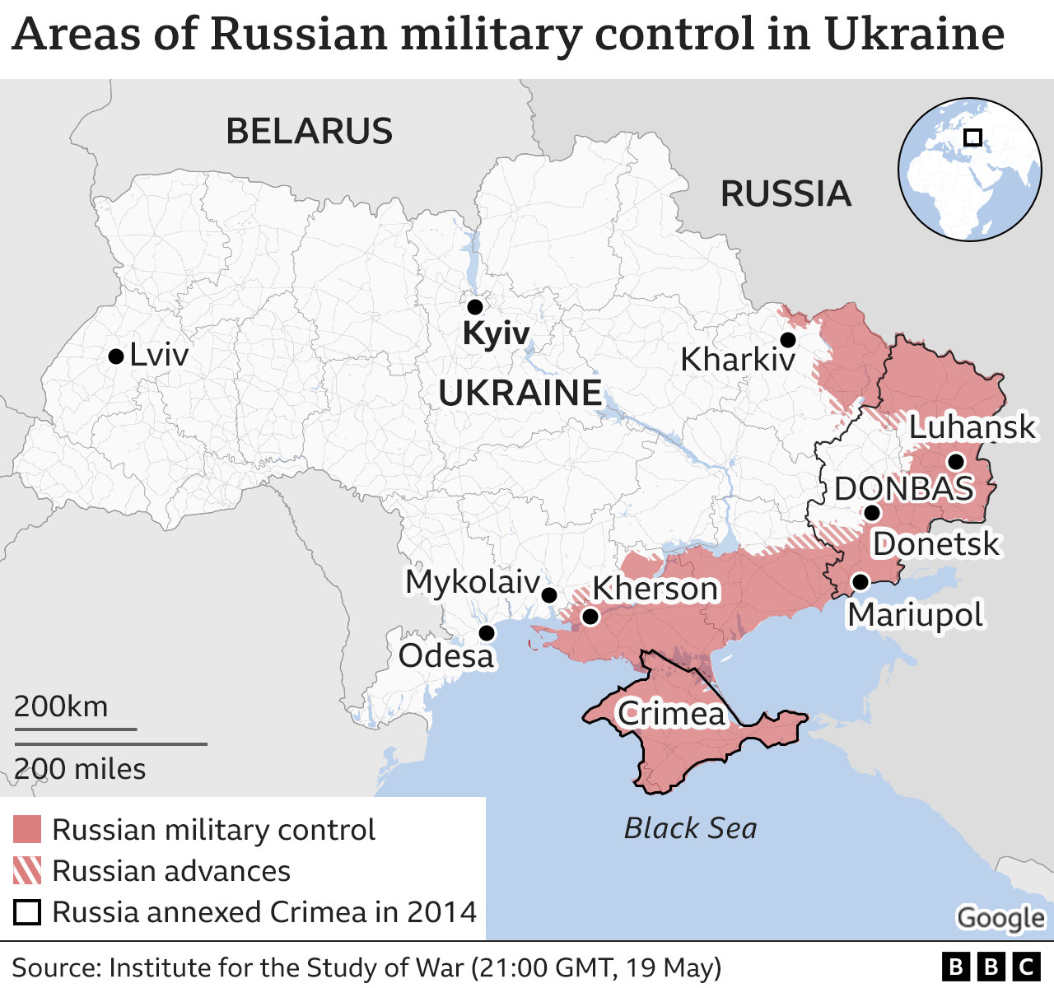
Visualizations inform the public and guide decision-making, policy, and business.
Politics
(CNN)
Health
(Financial Times)
Conflicts
(BBC)

Slide 4
Why do we do science?

Slide 5
Where do we put our scientific findings?

Slide 6
Who can access the science that we do?

Slide 7
Can you be a practicing researcher without access to the research that others are doing?

Slide 8
So in my own work, I ask: Who is excluded from doing research?

Slide 9
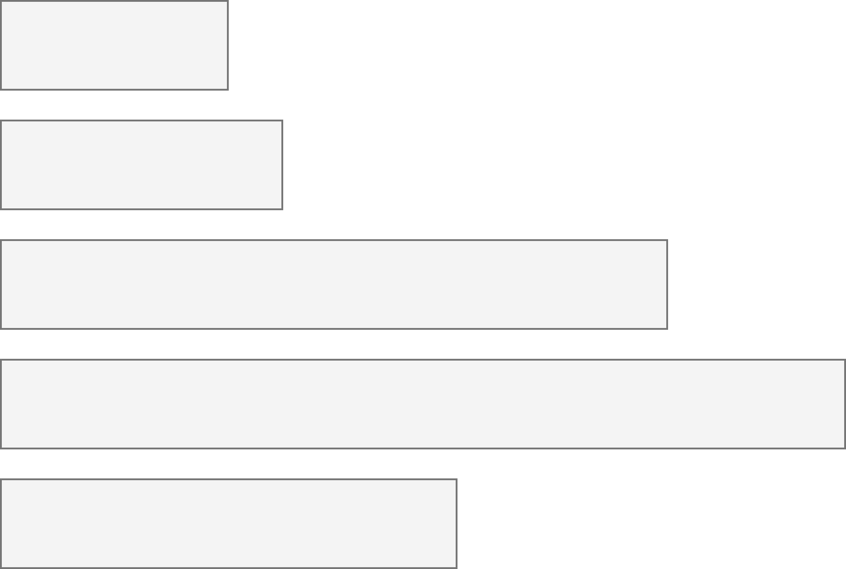
26% of people living in the United States self-report living with a disability that affects their daily life.
3.7%
Color Vision Deficiency
4.5%
Blindness, Low Vision
10.8%
Cognitive, Neurological
13.7%
Motor, Dexterity
7.4%
Vestibular, Motion
Source: Okoro et al. “Prevalence of Disabilities and Health Care Access by Disability Status and Type Among Adults”

Slide 10
Accessibility (some working definitions):
1. The qualities that make an experience open or usable to all.
2. The qualities that make an experience open or usable specifically for people with disabilities.

Slide 11
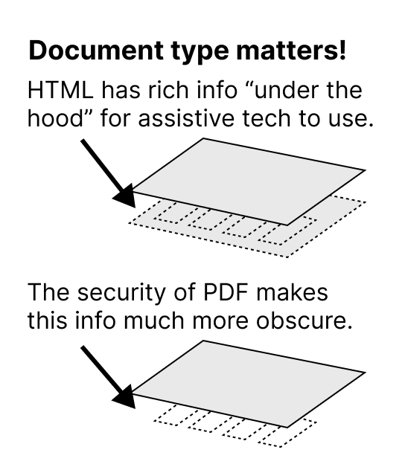


Slide 12
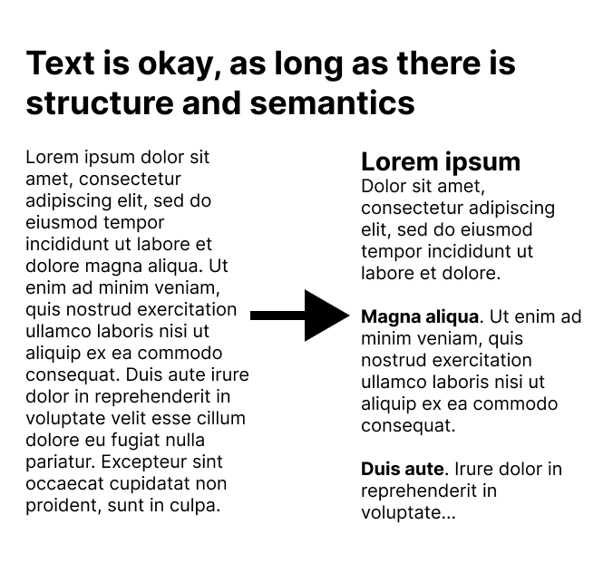

Slide 13
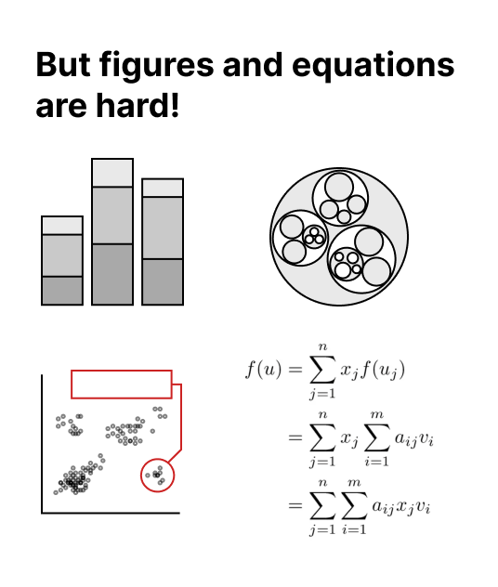

Slide 14
Conjecture 1: we can’t build a more accessible world if we don’t know how to recognize accessibility barriers.
14

Slide 15
Conjecture 2: most practitioners don’t know how to recognize accessibility barriers because learning how is difficult and intimidating.
15

Slide 16
My hypothesis: if we can collect and synthesize existing knowledge for practitioners into a usable artifact, we can improve how they do this work.
16

Slide 17
My prior work asks: How does someone know when a visualization is inaccessible?
17

Slide 18
Listen to people with disabilities.

Slide 19
There are a lot of ways to listen to PWD:
Actually ask them!
Find where they are already speaking.
Find where they have already spoken:
Research
Blog posts
Accessibility standards

Slide 20
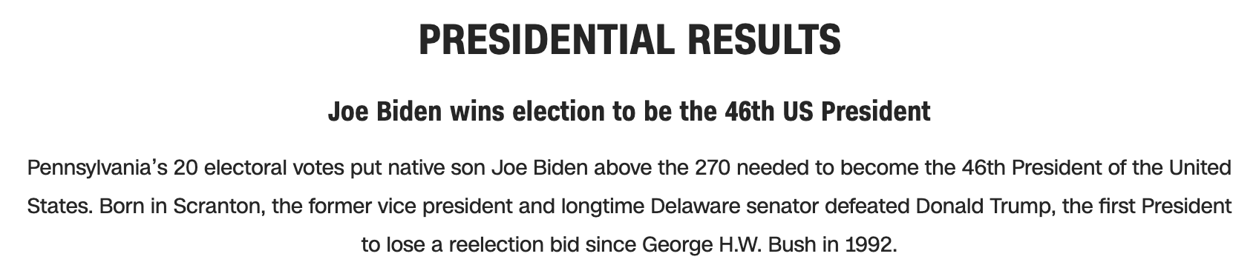
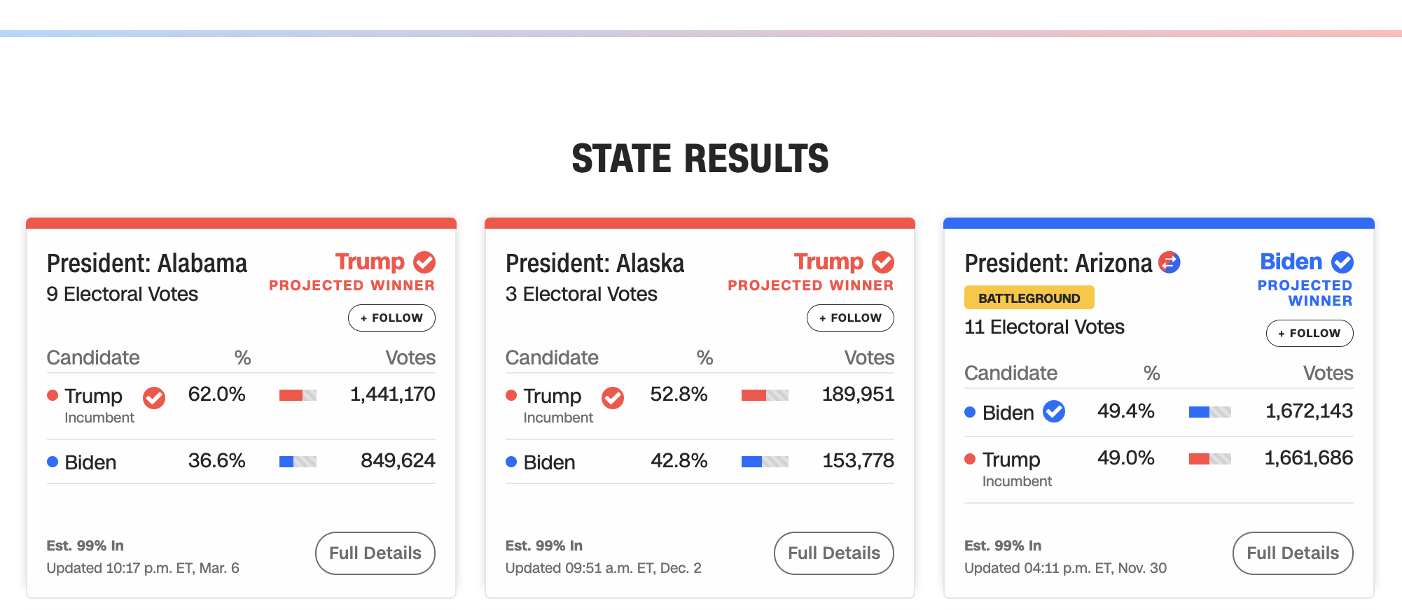

Let’s evaluate this one from CNN with Chartability.
20

Slide 21
Perceivable Failures
6 – Low contrast
57 - Content is only visual
50 - Color alone is used
1 - Meaningful elements can be distinguished
21

Slide 22
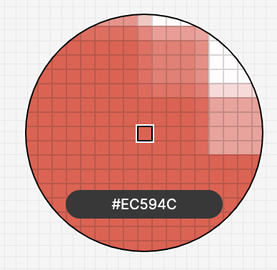
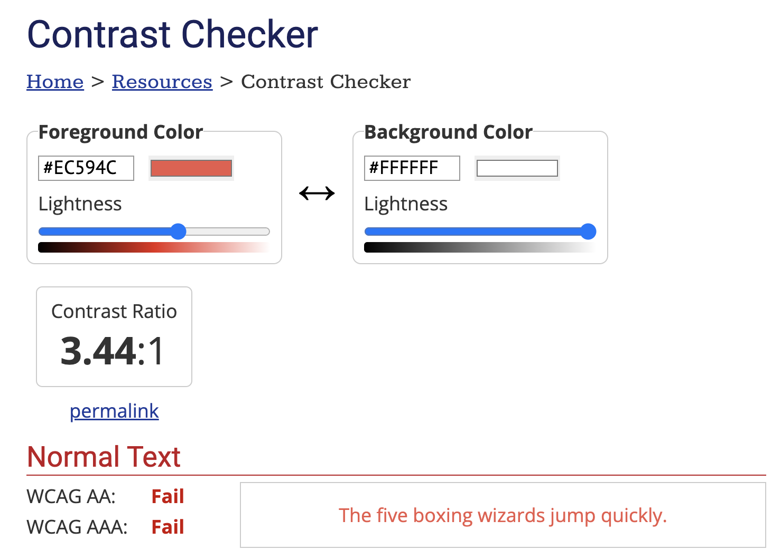

22

Slide 23
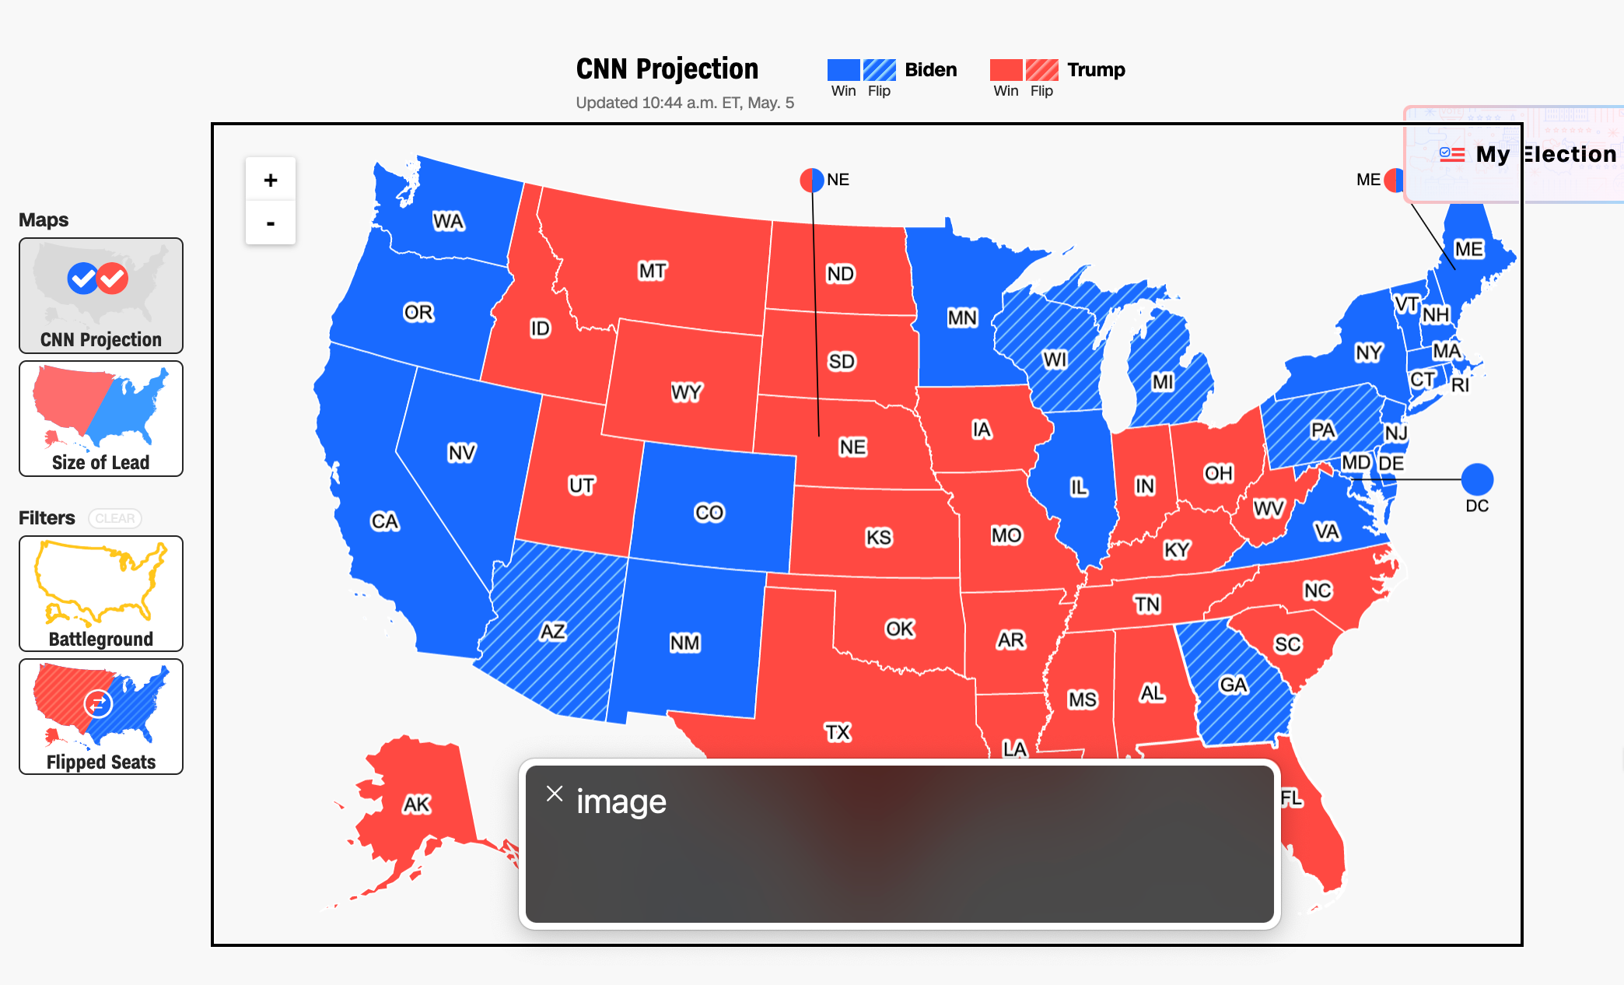
Perceivable Failures
6 – Low contrast
57 - Content is only visual
50 - Color alone is used
1 - Meaningful elements can be distinguished
23

Slide 24
Each state should announce to screen readers what state it is and who won it, not “image!”
24

Slide 25
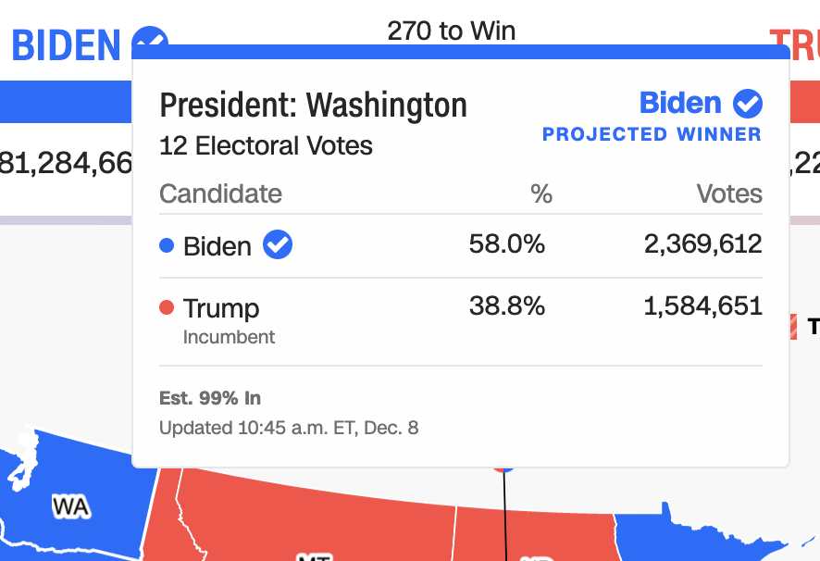
Operable Failures
54 - Interaction modality only has one input type
58 - No interaction cues or instructions
5 - Low contrast on interactive elements
4 - Keyboard focus indicator missing
4 - Complex actions have no alternative
18 - Target pointer interaction is too small
25

Slide 26


If a mouse can do something (like produce a tooltip), then there must be parity at least with a keyboard.
===
26

Slide 27
Operable Failures
54 - Interaction modality only has one input type
58 - No interaction cues or instructions
5 - Low contrast on interactive elements
4 - Keyboard focus indicator missing
4 - Complex actions have no alternative
18 - Target pointer interaction is too small
27

Slide 28
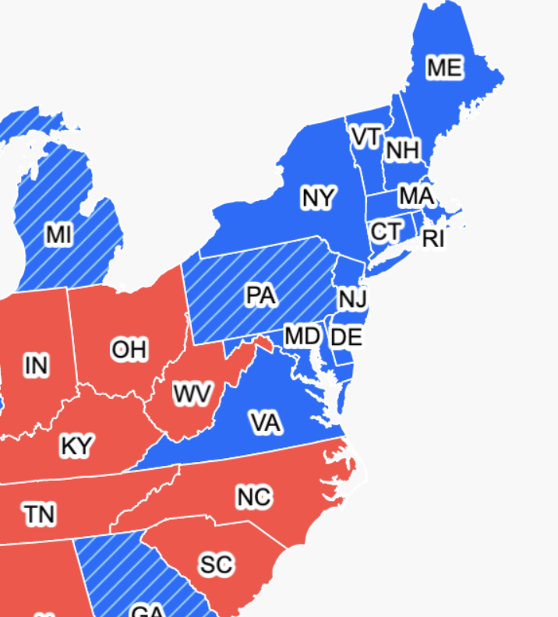

Expecting users to hover on something tiny is an accessibility design failure
28

Slide 29
Continue this for: Understandable,
Robust,
Compromising,
Assistive,
and Flexible
29

Slide 30
978 access failures found in ~60 minutes.
Robust:
275 - Does not conform to standards
82 - Semantically invalid
12 - Fragile technology support
Compromising:
54 - Information can only be reached through single process
61 - Information cannot be navigated according to narrative or structure
Assistive:
101 - Navigation and interaction is tedious
Flexible:
2 - User style change not respected
121 - User text adjustments are not respected
1 - Scrolling experiences cannot be adjusted or opted out of
Contrast and textures cannot be adjusted
Perceivable:
6 – Low contrast
57 - Content is only visual
50 - Color alone is used
3 - Meaningful elements can be distinguished
Operable:
54 - Interaction modality only has one input type
58 - No interaction cues or instructions
5 - Low contrast on interactive elements
4 - Keyboard focus indicator missing
4 - Complex actions have no alternative
18 - Target pointer interaction is too small
Understandable:
4 - Interactive context is not clear
6 - Metrics or variables are undefined
30
Notes:
Make sure to signal that this was from Chartability!!

Slide 31
Doing this work is hard.
31

Slide 32
Discuss: Why do people do this work?

Slide 33

1. Access is a human right
Accessibility is an internationally recognized human right.
It is the morally and ethically correct thing to do.
https://www.un.org/development/desa/disabilities/convention-on-the-rights-of-persons-with-disabilities/article-9-accessibility.html
https://www.un.org/development/desa/disabilities/convention-on-the-rights-of-persons-with-disabilities/article-10-right-to-life.html

Slide 34
2. It is expensive to exclude

Slide 35
15% of time spent on accessibility…
… for 26% of all people

Slide 36
Fixing inaccessibility takes 1.5 – 10x more time if done after something is built.

Slide 37
Time spent on accessibility during making:
Time spent making up for work not done:

Slide 38
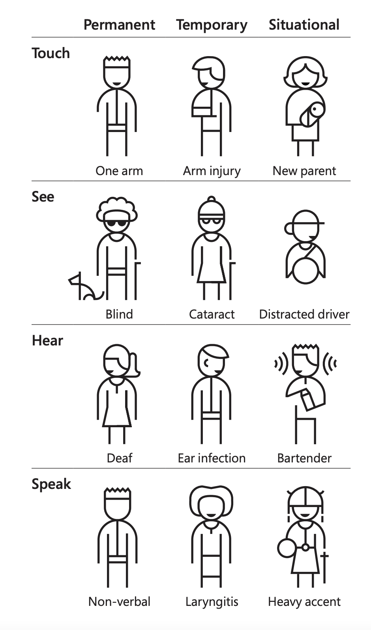
3. “Design for One, Extend to All” is better design work
Microsoft’s Inclusive Design 101 Toolkit: https://download.microsoft.com/download/b/0/d/b0d4bf87-09ce-4417-8f28-d60703d672ed/inclusive_toolkit_manual_final.pdf

Slide 39
Creators
39

Slide 40
Creators
Tools
40

Slide 41
Creators
Tools
Things
41

Slide 42
Creators
Tools
Things
Future Things
42

Slide 43
But how much of this is inaccessible?
Creators
Tools
Things
Future Things
43

Slide 44
97-99.9%
Creators
Tools
Things
Future Things
Source: World Wide Web Consortium. “The WebAIM Million.”
44

Slide 45
Dreaming of ideals
Creators
Tools
Things
Future Things
45
Notes:
Common, the way most people do this work

Slide 46
The knowledgeable “specialist” intervenes
Creators
Tools
Things
Future Things
46
Notes:
Common, the way most people do this work

Slide 47
We change our systems, laws, and environments
Creators
Tools
Things
Future Things
47

Slide 48
We give creators better tools
Creators
Tools
Things
Future Things
48

Slide 49
Chartability seeks to add knowledge as a tool to motivate practitioner behavior.
Creators
Knowledge
Created Things (now)
Future Things
49

Slide 50
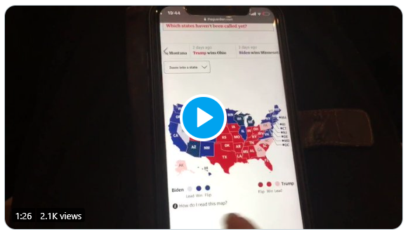
What is an inaccessible experience like?
Credit: Sarah Fossheim on twitter

Slide 51
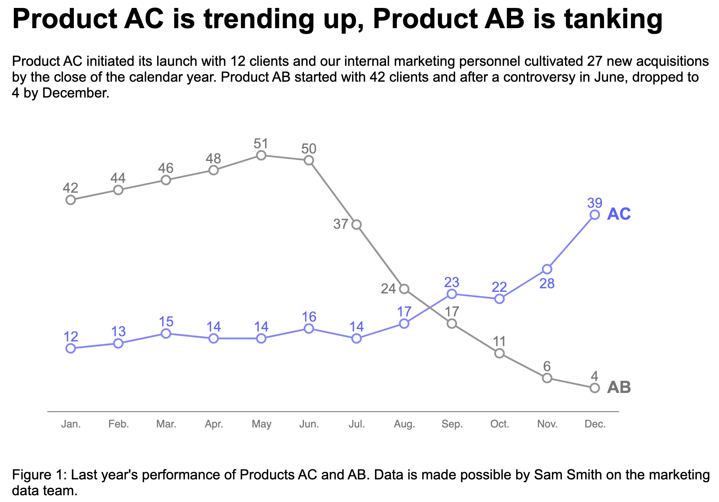
Explore: An interactive bar chart
https://frankelavsky.github.io/assessing_chart_interactivity/

Slide 52
Discuss!
What was it like to listen to a screen reader?
What are some differences between the chart and the “inaccessible” version?
Why did one chart work and another not work?

Slide 53
Our challenge:
Can future research consider more than just visual disabilities?
53

Slide 54
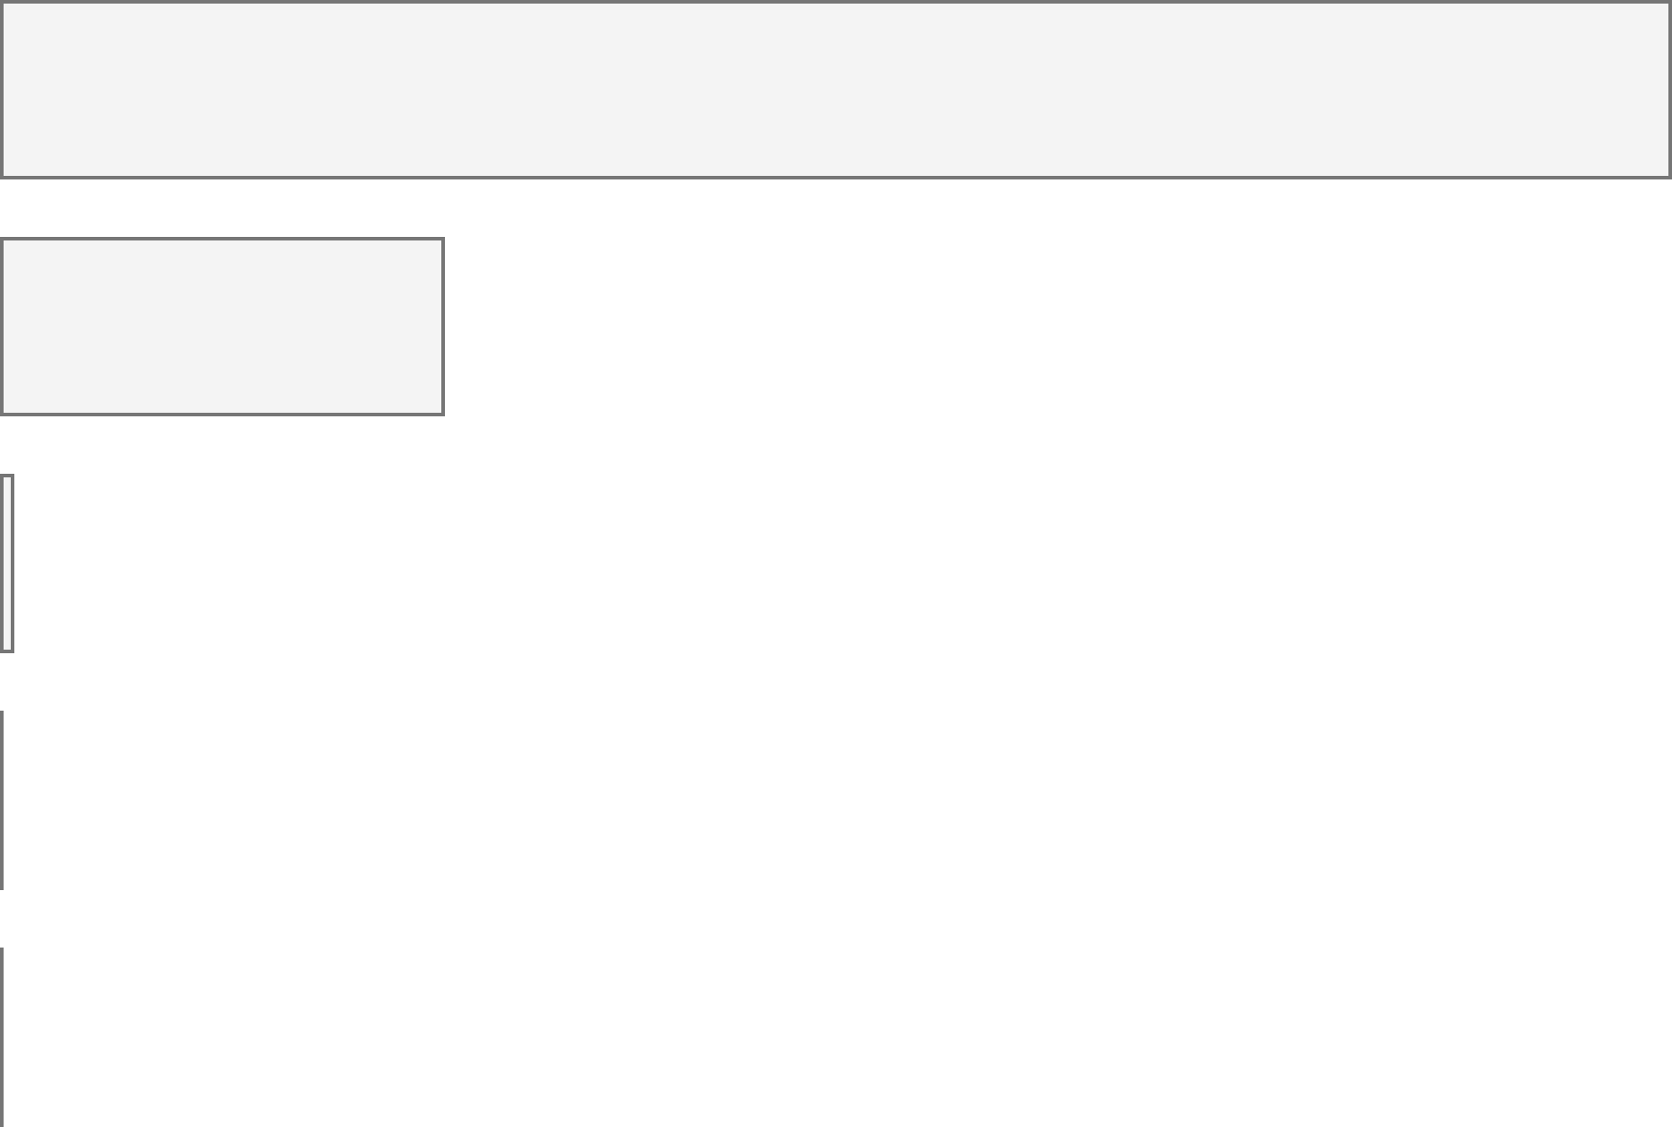
Disabilities in the US
Accessibility in Visualization Research
Color Vision Deficiency
3.7%
Color Vision Deficiency
233
Blindness, Low Vision
4.5%
Blindness, Low Vision
62
Cognitive, Neurological
10.8%
Cognitive, Neurological
2
Motor, Dexterity
13.7%
Motor, Dexterity
0
Vestibular, Motion
7.4%
Vestibular, Motion
0
54

Slide 55
Every area of disability affects data visualization work.
Visual design
3.7%
Color Vision Deficiency
Non-visual design
4.5%
Blindness, Low Vision
Narrative design, statistics, storytelling
10.8%
Cognitive, Neurological
13.7%
Motor, Dexterity
Interaction design, device considerations, performance
7.4%
Vestibular, Motion
Animation, transitions
55

Slide 56
My current work:
How do technical design materials influence practitioner behavior?
56

Slide 57
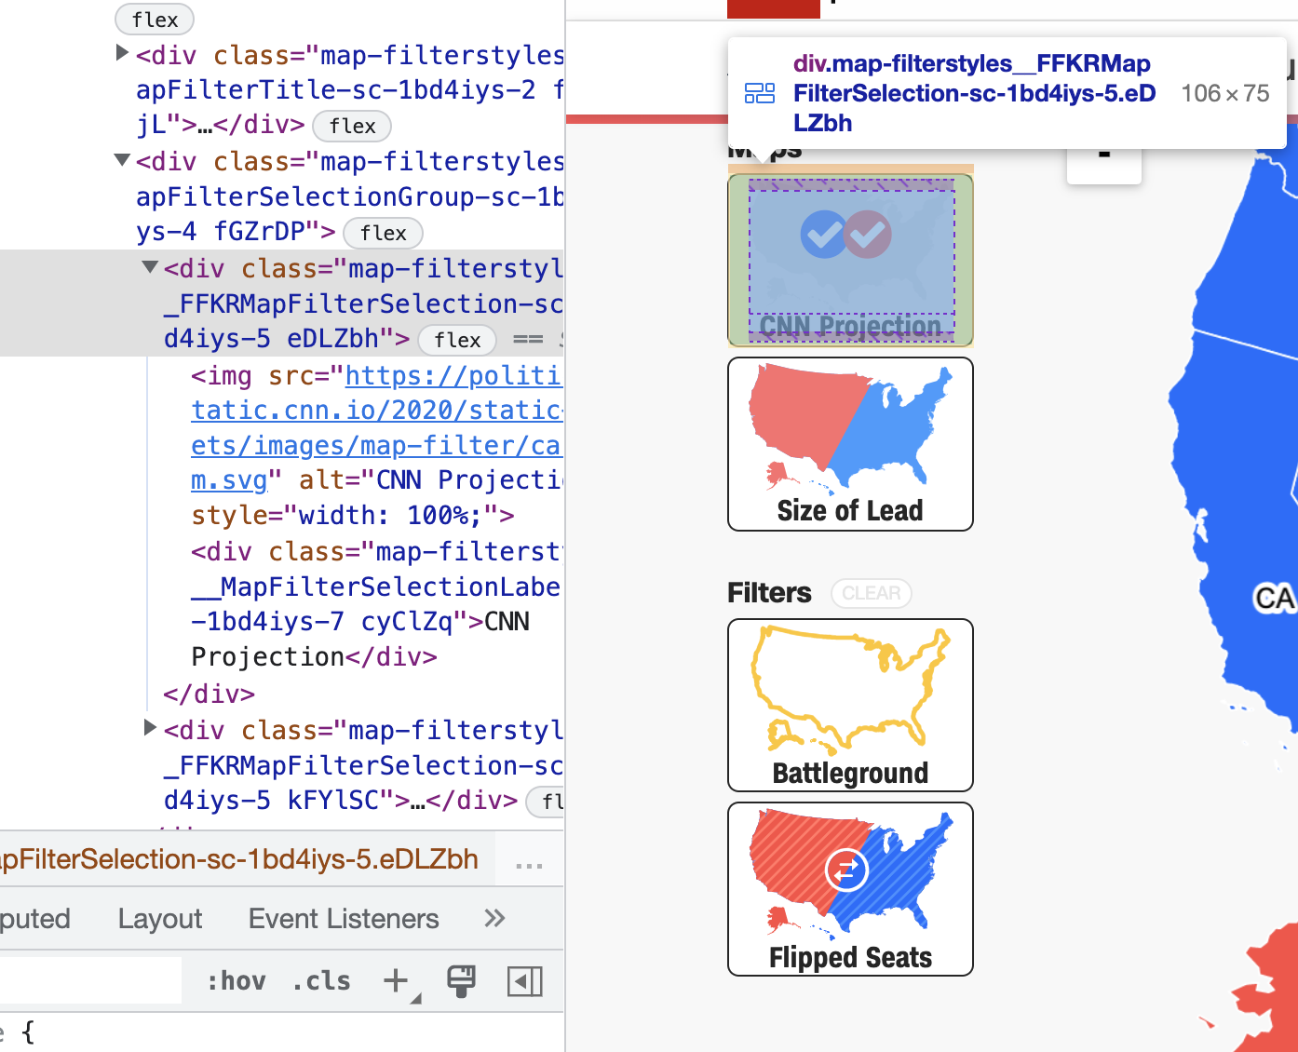
Why do practitioners use tools and materials that produce inaccessible outcomes?
57

Slide 58
Can tools shape how practitioners imagine the potential of their work?
58

Slide 59
Working conjecture:
Better tools and materials can broaden who is included as a creator, author, designer, and engineer.
59

Slide 60
Q/A
Happy to answer questions about how to do this work professionally (design, engineering, research, education)
as well as any questions about data visualization and accessibility more broadly (including tools, challenges, what lies in the future)

Slide 61
Resources
A resources repository!
My twitter (@FrankElavsky)
Chartability

Slide 62
Consider the following section as a great guide for you to refer to later! (We don’t have time to go over all of it today.)

Slide 63
Perceivable
Can someone perceive this in multiple ways? Is each way easy?

Slide 64
Perceivable Checklist:
High Contrast
CVD-Safe + Redundant Encoding
Alt Text

Slide 65
Design with high contrast
Colorblindness Disproportionately Overrepresented in A11y Resources
Colorblindness Disproportionately Overrepresented in A11y Resources
Colorblindness: % of People
Colorblindness: % of People
4%
4%
Low Vision: % of People
Low Vision: % of People
25%
25%
Colorblindness: # of Resources
Colorblindness: # of Resources
51
51
Low Vision: # of Resources
Low Vision: # of Resources
5
5
Notes:
https://projects.susielu.com/viz-palette

Slide 66
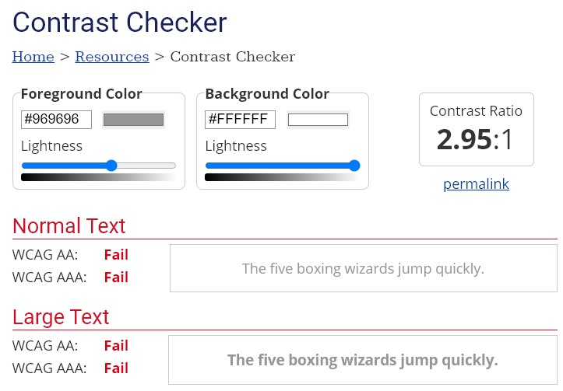
Use High Contrast Text
Text needs at least 4.5:1 contrast against its background.
Large text (bold and 16pt or larger) can be 3:1 or higher.

Slide 67
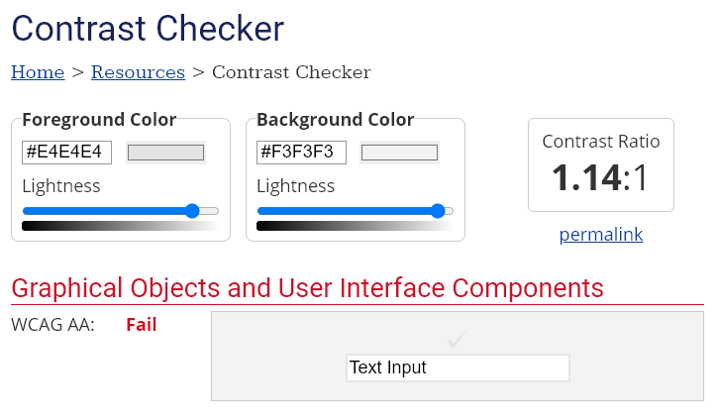
Use High Contrast Geometries
Chart elements need at least 3:1 contrast against their background.

Slide 68
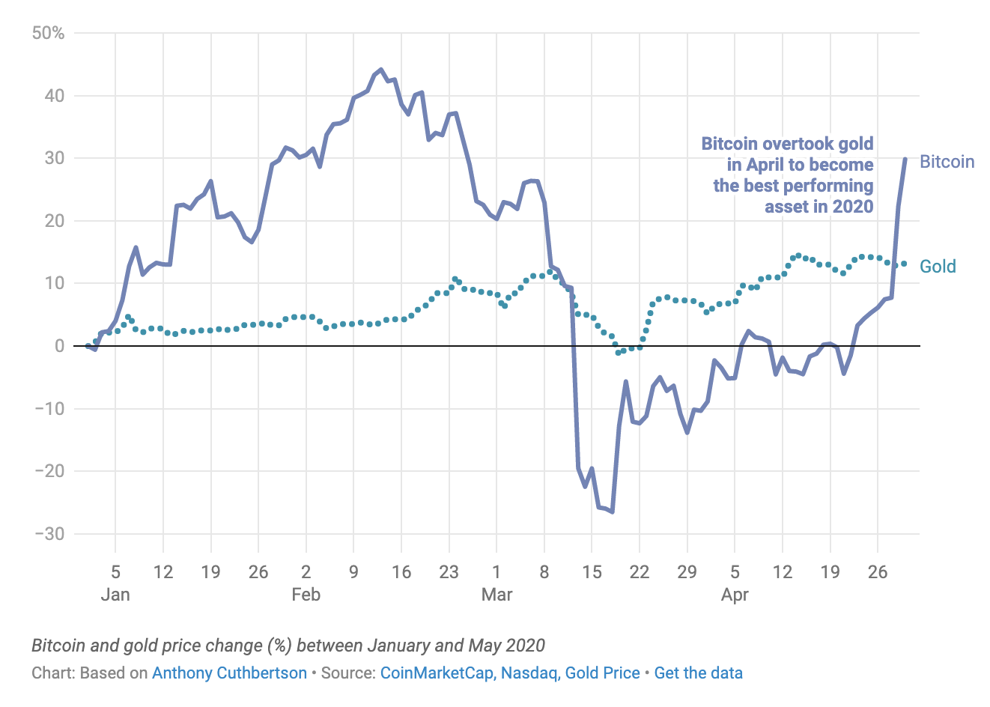
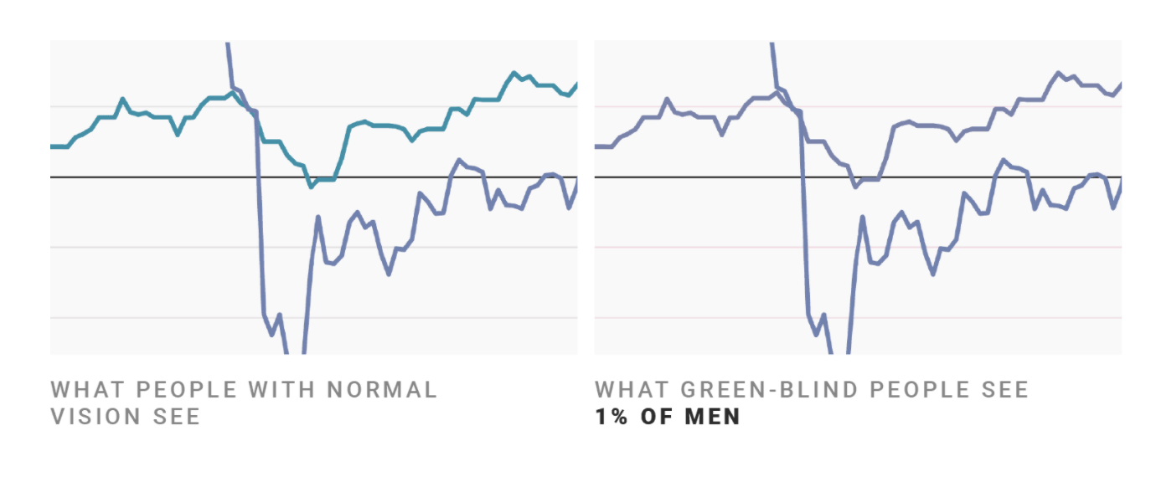
Don’t rely on color alone!
(Muth) https://blog.datawrapper.de/colorblindness-part2/

Slide 69
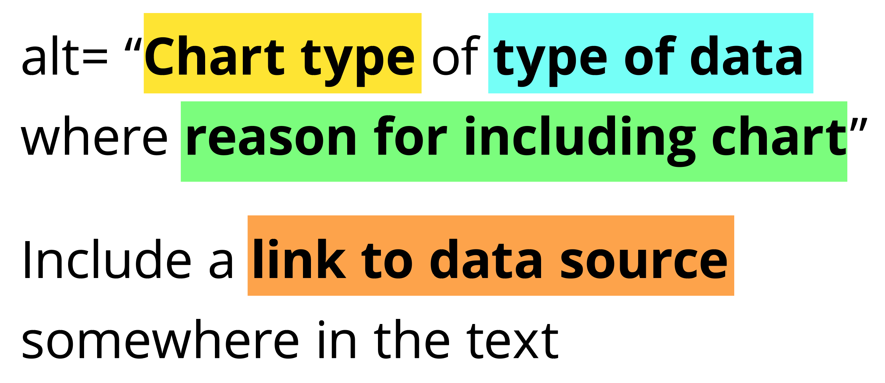
Add alt text
There is great research on alt text, but the most important thing to know is that you should add it to every image you post online (including twitter), in a document, or presentation.
Guidance: https://medium.com/nightingale/writing-alt-text-for-data-visualization-2a218ef43f81

Slide 70
Perceivable Evaluation Toolkit:
Contrast Checker
Safe color design
CVD Checker
Redundant encoding design ideas
Alt Text

Slide 71
Operable
Can someone operate this in multiple ways? Is each way easy?

Slide 72
Operable Checklist:
Mouse
Keyboard-only
Screen Reader

Slide 73
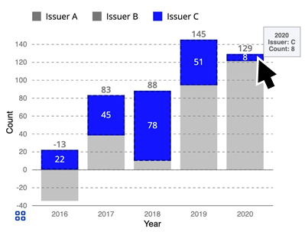
Ensure Keyboard Access (if interactive)

Slide 74
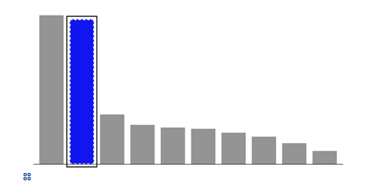
Indicate keyboard focus, use multi-modal style
This is a keyboard focus indicator (outer border) with the same styling effect applied on mouse hover (inner dashed white lines and blue fill)

Slide 75
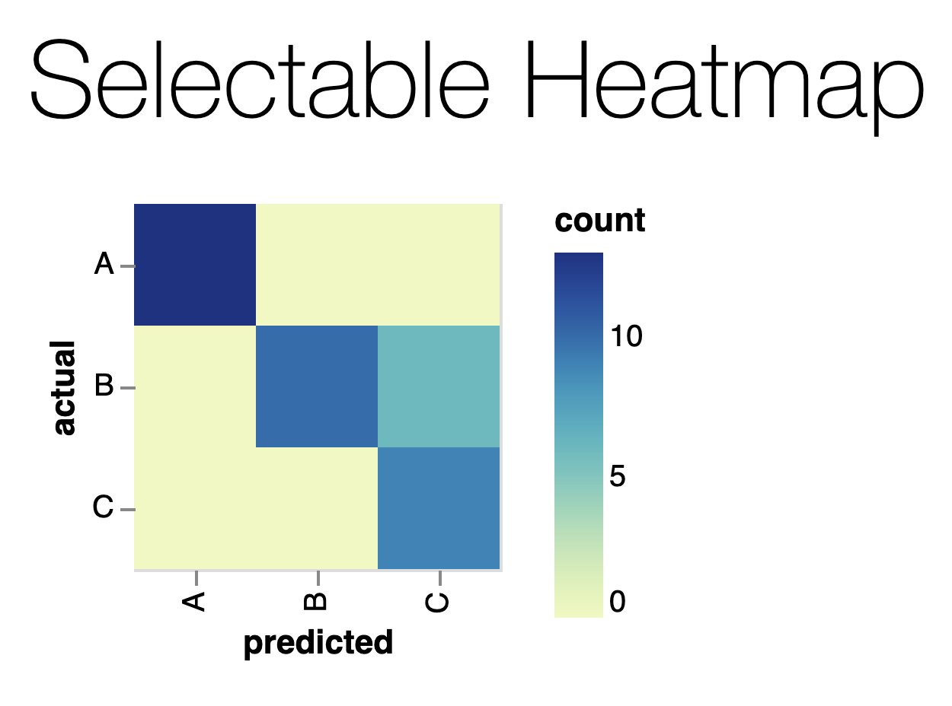
Why Keyboard-only?
Some things work for screen readers but not for keyboard-only users!
https://vega.github.io/vega-lite/examples/selection_heatmap.html

Slide 76
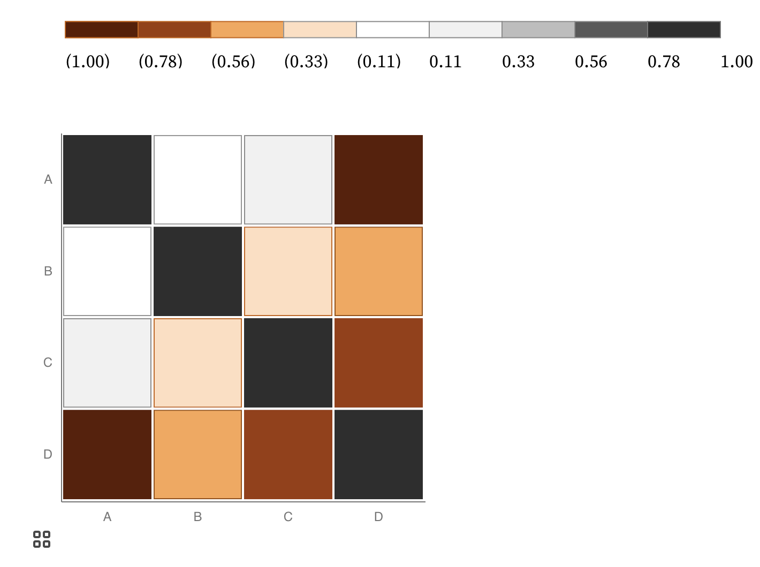
Keyboard only example:
https://observablehq.com/@frankelavsky/experimental-color-scale-textures

Slide 77
Operable Evaluation Toolkit:
Use your mouse: can it do something meaningful? (tooltip, click event, etc) If so:
Test using a keyboard-only: can you navigate and use keyboard activation (spacebar/enter) on the visualization?
Test using a screen reader: Can you use a screen reader to navigate and use keyboard activation on the visualization?

Slide 78
Understandable
Can someone understand this in multiple ways? Is each way easy?

Slide 79
Understandable Checklist:
Descriptive title, summary, or caption
Data table or data download
Reading level

Slide 80
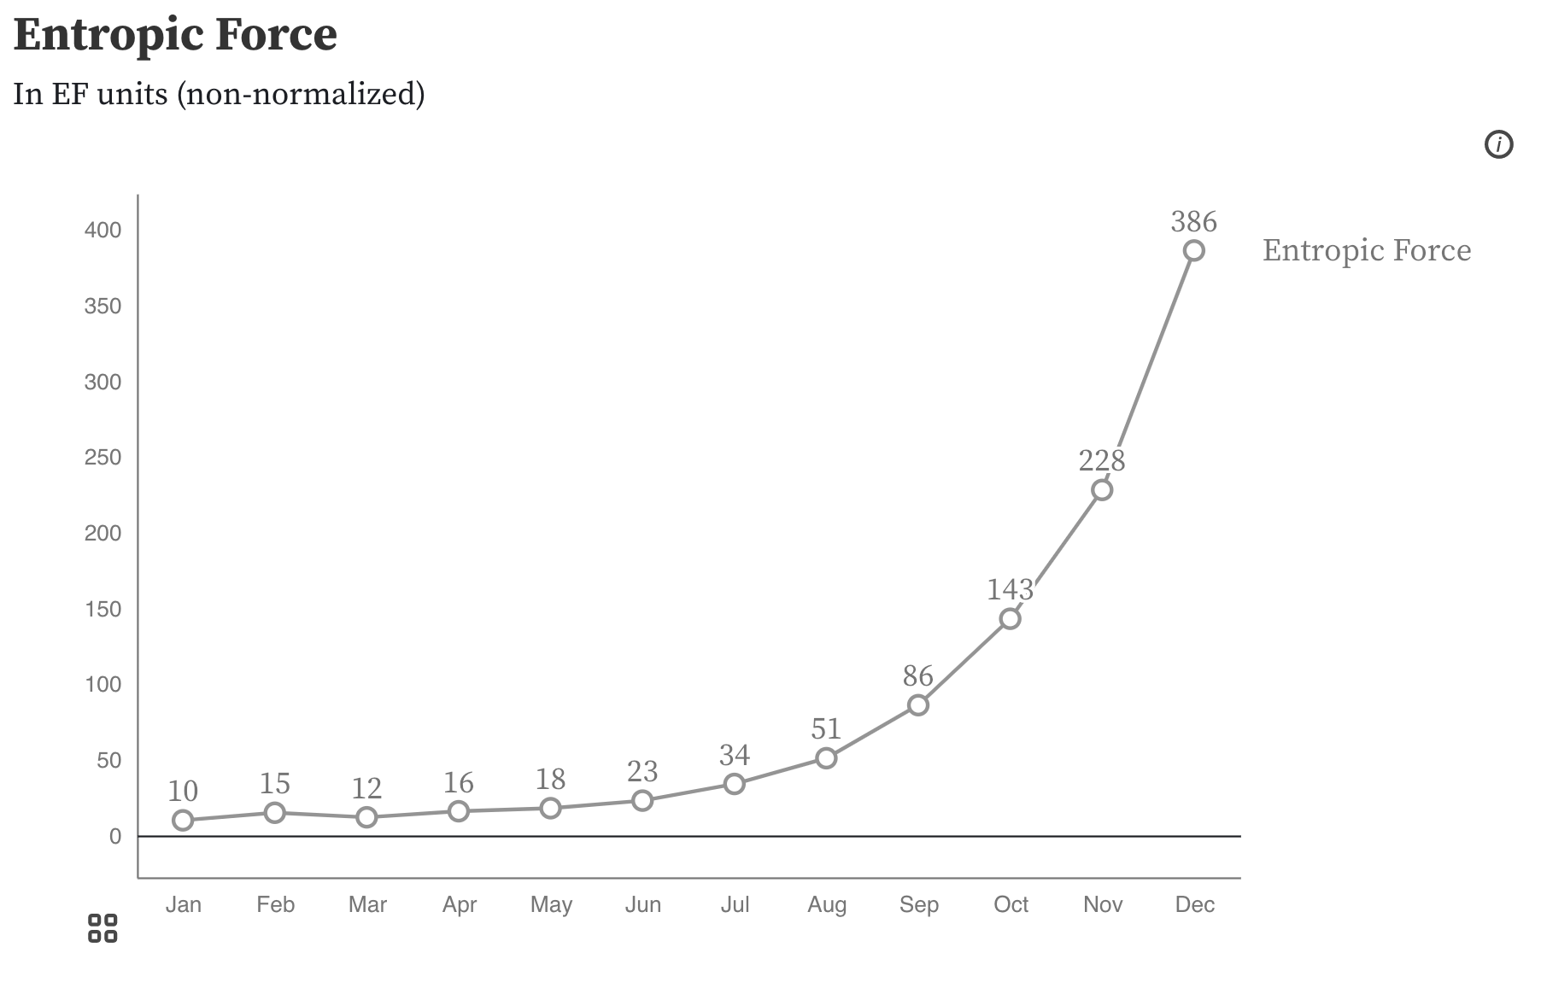
Non-descriptive titles are inaccessible

Slide 81
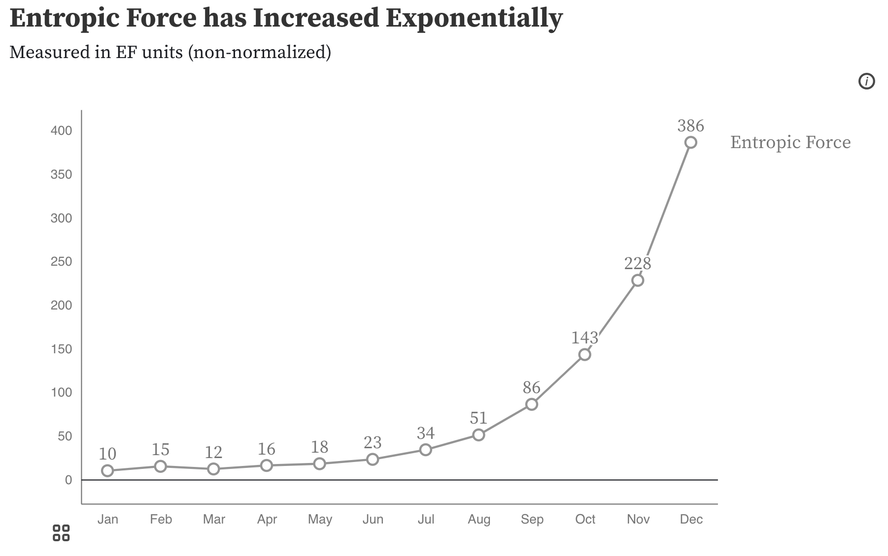
Descriptive titles have summaries/takeaways

Slide 82
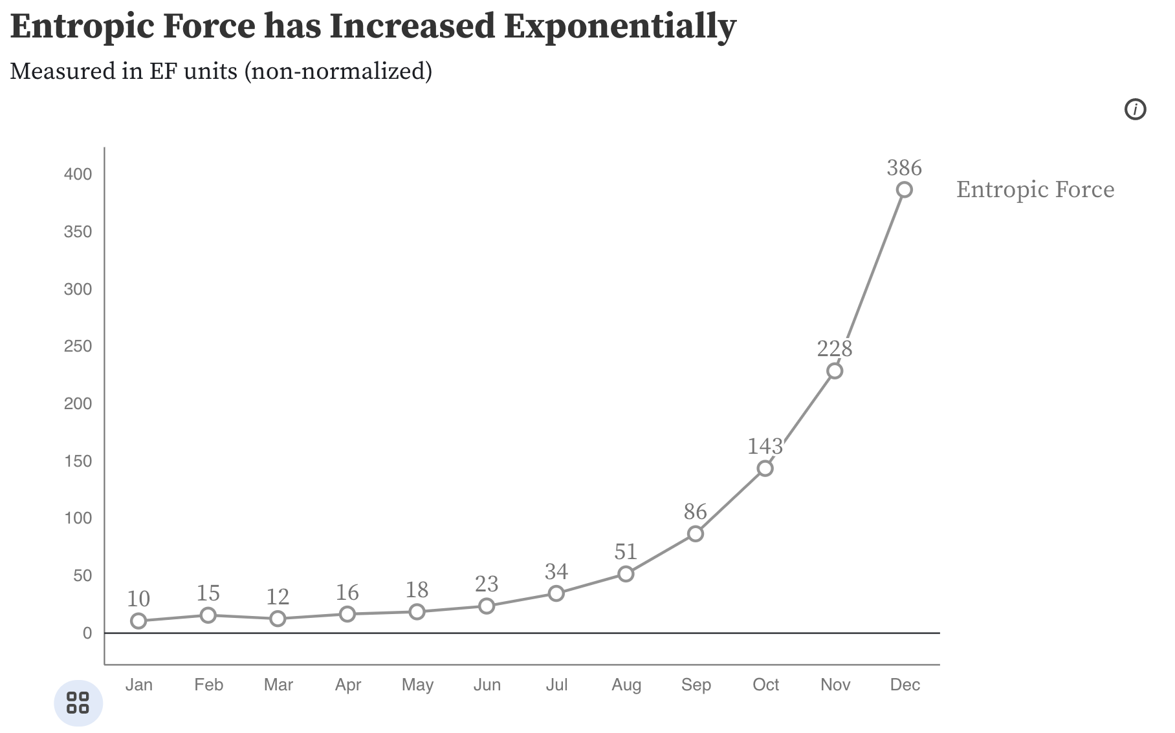
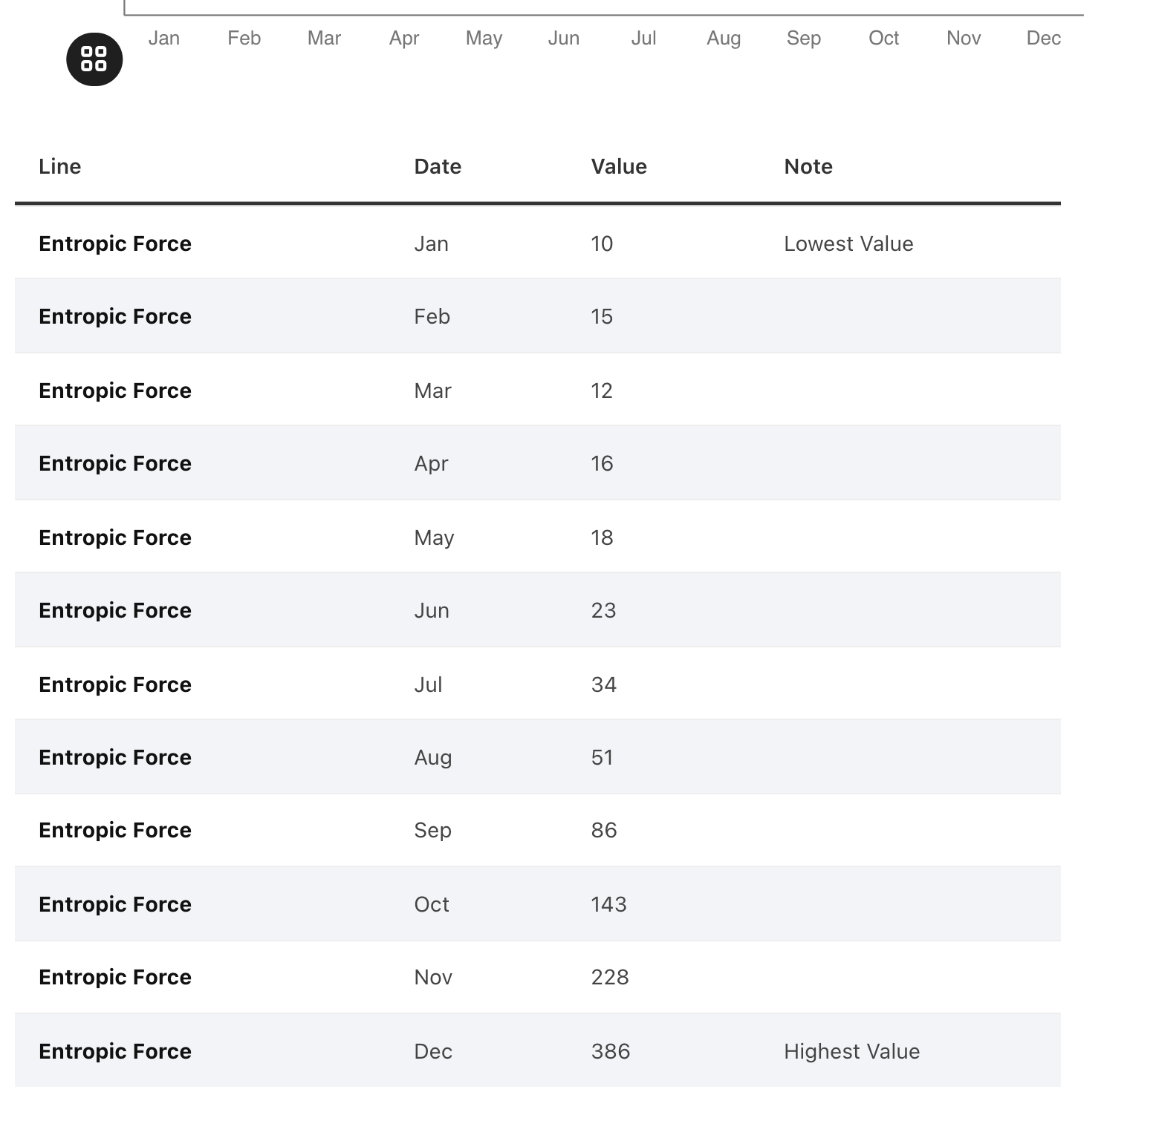
All charts should have data available!

Slide 83
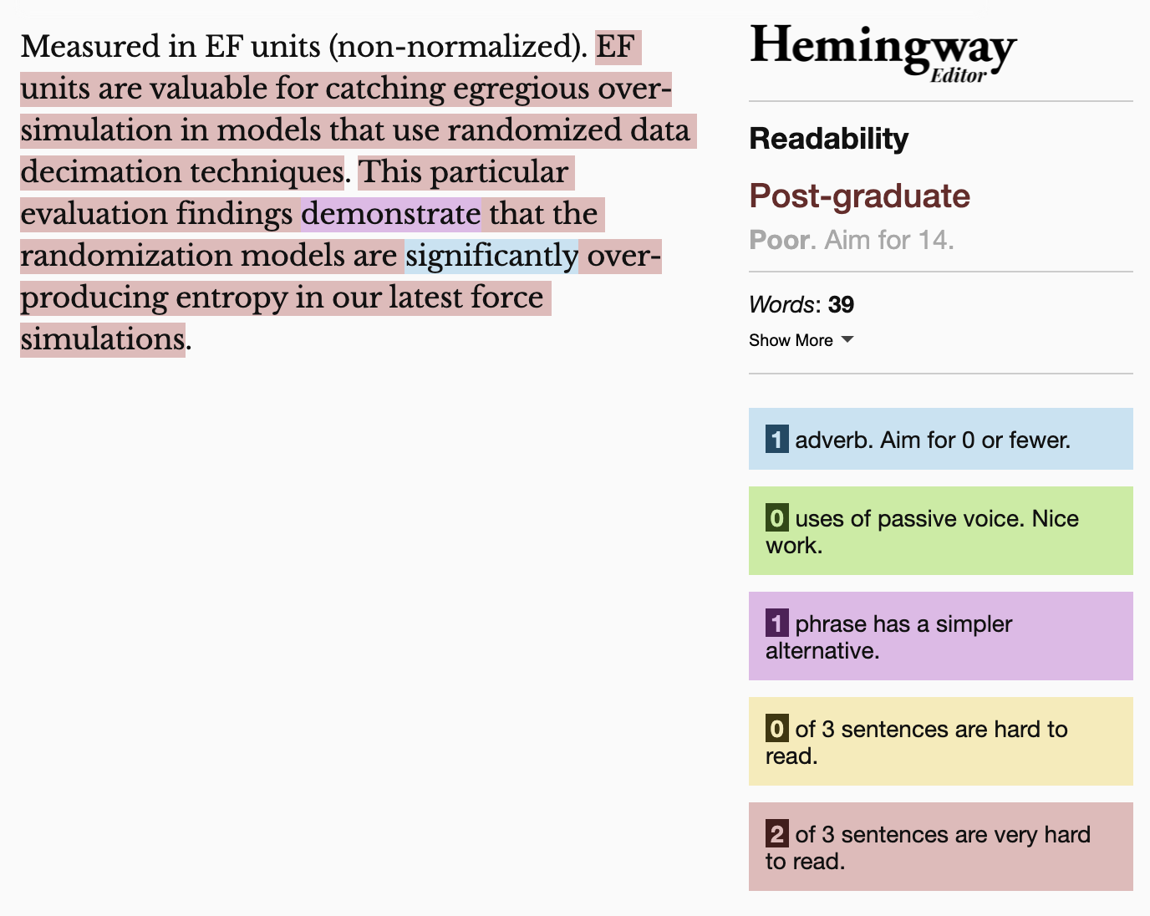
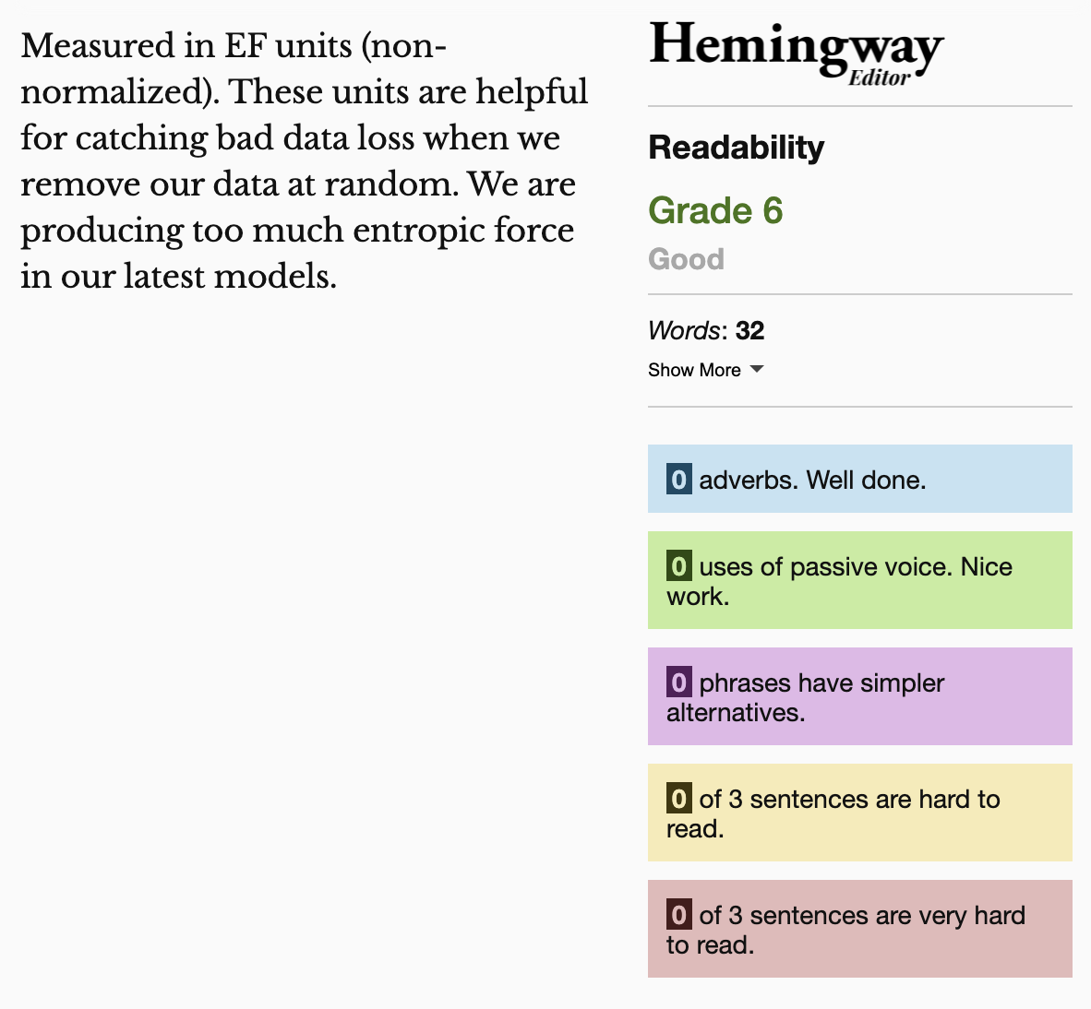
Keep summaries as non-technical as possible
If the topic is technical, provide a “plain language” summary somewhere close by that is easy to find (either in the same location or with by providing a link).

Slide 84
Understandable Evaluation Toolkit:
Is there a descriptive title, summary, or caption?
Is there an accessible table or downloadable data file provided?
Is the descriptive text supporting the visualization presented at a reading level at grade 9 or below?

